Slide 1
Extended Entity-Relationship
(EER) Model
Notes:
EER is a high-level data model that incorporates the extensions to the original ER model. Enhanced ERD are high level models that represent the requirements and complexities of complex database.
In addition to ER model concepts EE-R includes −
Subclasses and Super classes.
Specialization and Generalization.
Category or union type.
Aggregation.

Slide 2
EER Model
EER stands for Enhanced ER or Extended ER.
Includes all modeling concepts of basic ER.
Additional concepts:
  subclasses/superclasses
  specialization/generalization
  categories (UNION types)
  attribute and relationship inheritance
Constraints on Specialization/Generalization
The additional EER concepts are used to model applications more completely and more accurately.
EER includes some object-oriented concepts, such as inheritance.

Slide 3
Subclass and Superclass
An entity type may have additional meaningful subgroupings of its entities
  Example: EMPLOYEE may be further grouped into:
    SECRETARY, ENGINEER, TECHNICIAN, …
      Based on the EMPLOYEE’s Job
    MANAGER
      EMPLOYEEs who are managers (the role they play)
    SALARIED_EMPLOYEE, HOURLY_EMPLOYEE
      Based on the EMPLOYEE’s method of pay
EER diagrams extend ER diagrams to represent these additional subgroupings, called subclasses or subtypes.
Each of these subgroupings is a subset of EMPLOYEE entities.
Each is called a subclass of EMPLOYEE.
EMPLOYEE is the superclass for each of these subclasses.
Notes:
Super class is an entity that can be divided into further subtype.

Slide 4
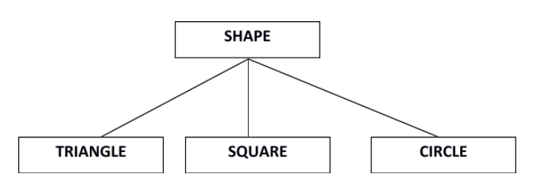
Subclass and Superclass
Superclass/subclass relationships:
  EMPLOYEE/SECRETARY
  EMPLOYEE/TECHNICIAN
  EMPLOYEE/MANAGER
These are also called IS-A (or IS-AN) relationships
  SECRETARY IS-AN EMPLOYEE, TECHNICIAN IS-AN EMPLOYEE
An entity that is member of a subclass represents the same real-world entity as some member of the superclass.
The subclass member is the same entity in a distinct specific role.
  Super class shape has sub groups: Triangle, Square and Circle.

Slide 5
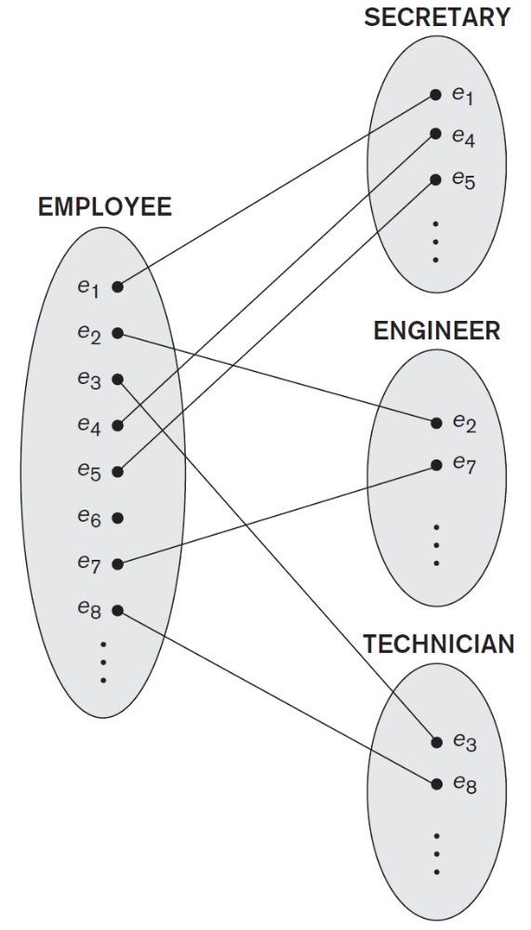
Subclass and Superclass

Slide 6
Subclass and Superclass
Examples
  A salaried employee who is also an engineer belongs to the two subclasses:
    ENGINEER, and
    SALARIED_EMPLOYEE
  A salaried employee who is also an engineering manager belongs to the three subclasses:
    MANAGER,
    ENGINEER, and
    SALARIED_EMPLOYEE
It is not necessary that every entity in a superclass be a member of some subclass

Slide 7
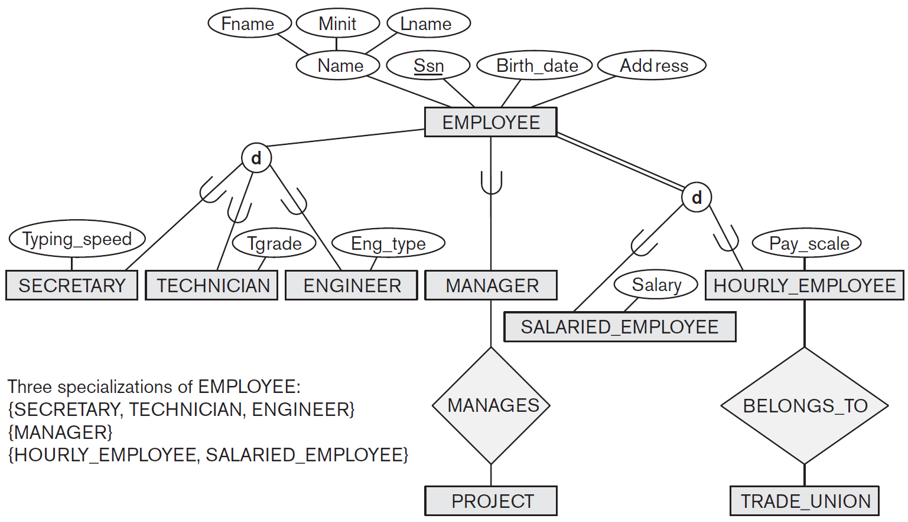
EER diagram notation to represent subclasses and specialization

Slide 8
Inheritance
An entity that is member of a subclass inherits
  All attributes of the entity as a member of the superclass
  All relationships of the entity as a member of the superclass
Example
  SECRETARY (as well as TECHNICIAN and ENGINEER) inherit the attributes Name, SSN, …, from EMPLOYEE
  Every SECRETARY entity will have values for the inherited attributes.

Slide 9
Specialization
The process of designating subgroupings within an entity set is called specialization or a process in which an entity is divided into sub-entities.
Specialization is the process of defining a set of subclasses of a superclass.
The set of subclasses is based upon some distinguishing characteristics of the entities in the superclass.
Example
  {SECRETARY, ENGINEER, TECHNICIAN} is a specialization of EMPLOYEE based upon job type.
  MANAGER is a specialization of EMPLOYEE based on the role the employee plays.
  {SALARIED_EMPLOYEE, HOURLY_EMPLOYEE} is a specialization of EMPLOYEE based on method of pay.
May have several specializations of the same superclass.
Superclass/subclass relationships and specialization can be diagrammatically represented in EER diagrams.

Slide 10
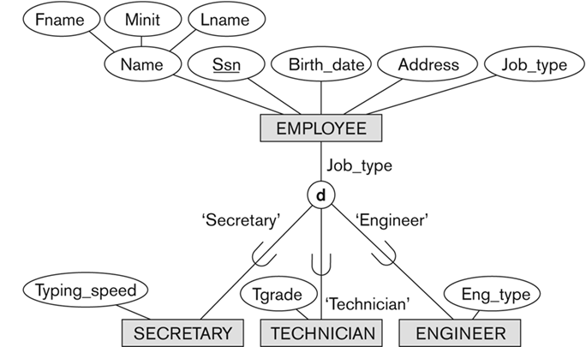
Specialization

Slide 11
Specialization
Attributes of a subclass are called specific or local attributes.
  For example, the attribute TypingSpeed of SECRETARY
The subclass can also participate in specific relationship types.
  For example, a relationship BELONGS_TO of HOURLY_EMPLOYEE
Top-down design process: we designate sub-groupings within an entity set that are distinctive from other entities in the set.
Depicted by a triangle component labeled ISA.
A lower-level entity set inherits all the attributes and relationship participation of the higher-level entity set to which it is linked.

Slide 12
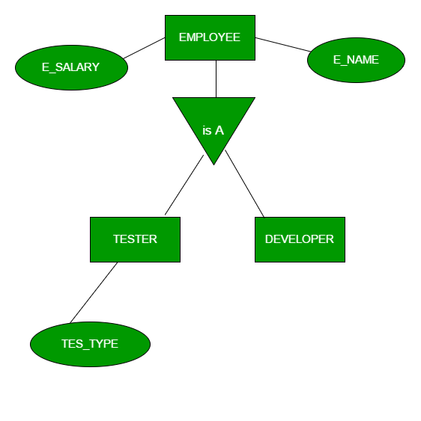
Specialization

Slide 13
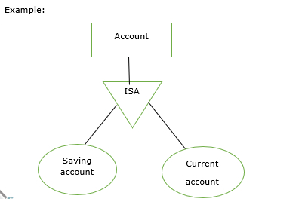
Specialization
Overlapping specialization
  An entity may belong to multiple specialized entity sets
Disjoint specialization
  An entity must belong to at most one specialized entity set.
Disjoint i.e. An animal can either be Panda or be Dog or be Cheetah but can't be any two or more at the same time
Overlapping I.e. A person who knows Java and PHP can participate in both teams, A person can be a Woman and that same Woman can be Driver and that same Woman can be Engineer at the same time
Disjoint Account users can participate in saving account and current account but both are different so, it can be participated one at a time.
Notes:
The disjoint rule states an entity instance of a supertype can only be a member of one subtype. The overlap rule states an entity instance of a supertype can be a member of multiple subtypes.
Example of disjoint rule: Instance of Super-type Animal can only be member of exactly one of these Sub-types being Panda, Cheetah and Dog Disjoint Union , (An animal can either be Panda or be Dog or be Cheetah but can't be any two or more at the same time)
Example of overlap rule: Instance of Super-type Person can be member of multiple Sub-types being Woman, Driver and Engineer Overlapping Union , (A person can be a Woman and that same Woman can be Driver and that same Woman can be Engineer at the same time)

Slide 14
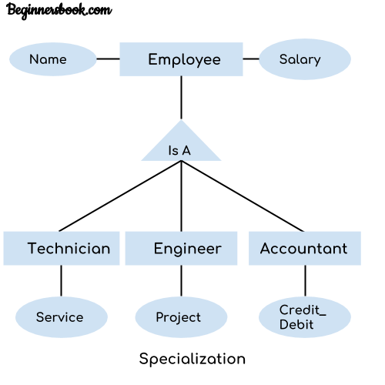
GENERALIZATION

Slide 15
Generalization
Generalization is the reverse of the specialization process.
Several classes with common features are generalized into a superclass.
  Original classes become its subclasses
Example: CAR, TRUCK generalized into VEHICLE
  Both CAR, TRUCK become subclasses of the superclass VEHICLE.
  We can view {CAR, TRUCK} as a specialization of VEHICLE.
  Alternatively, we can view VEHICLE as a generalization of CAR and TRUCK.
Generalization refers to the process of defining a generalized entity type from the given entity types.
Generalization is the process of extracting common properties from a set of entities and create a generalized entity from it.

Slide 16
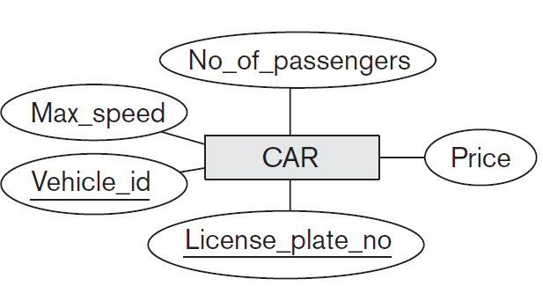
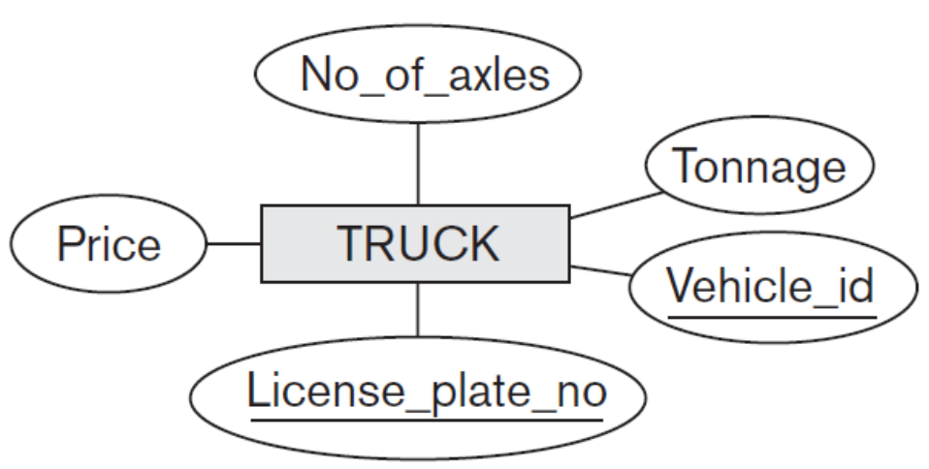
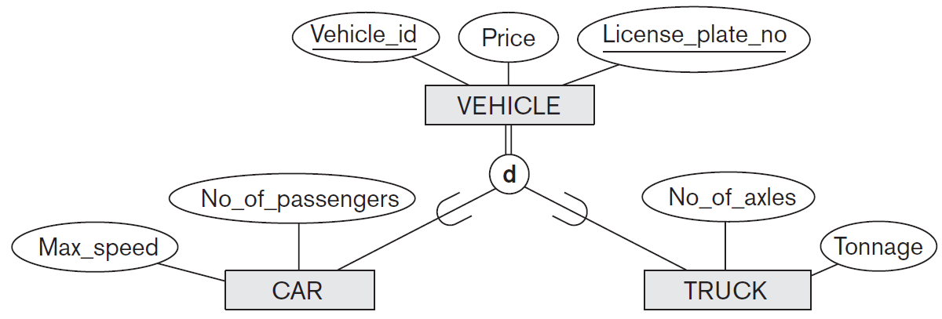
Generalization

Slide 17
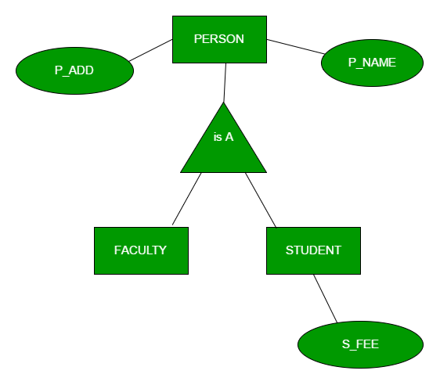
Notations for Generalization and Specialization
Diagrammatic notations are sometimes used to distinguish between generalization and specialization
  Arrow pointing to the generalized superclass represents a generalization
  Arrows pointing to the specialized subclasses represent a specialization

Slide 18
Generalization
Bottom-up design process – combine a number of entity sets that share the same features (attributes) into a higher-level entity set.
Specialization and generalization are inversions of each other.
Single inheritance - In a hierarchy, a given entity set is involved as a lower-level entity set in only one ISA relationship.
Multiple inheritance - If an entity set is a lower-level entity set in more than one ISA relationship, then the entity set has multiple inheritance.

Slide 19
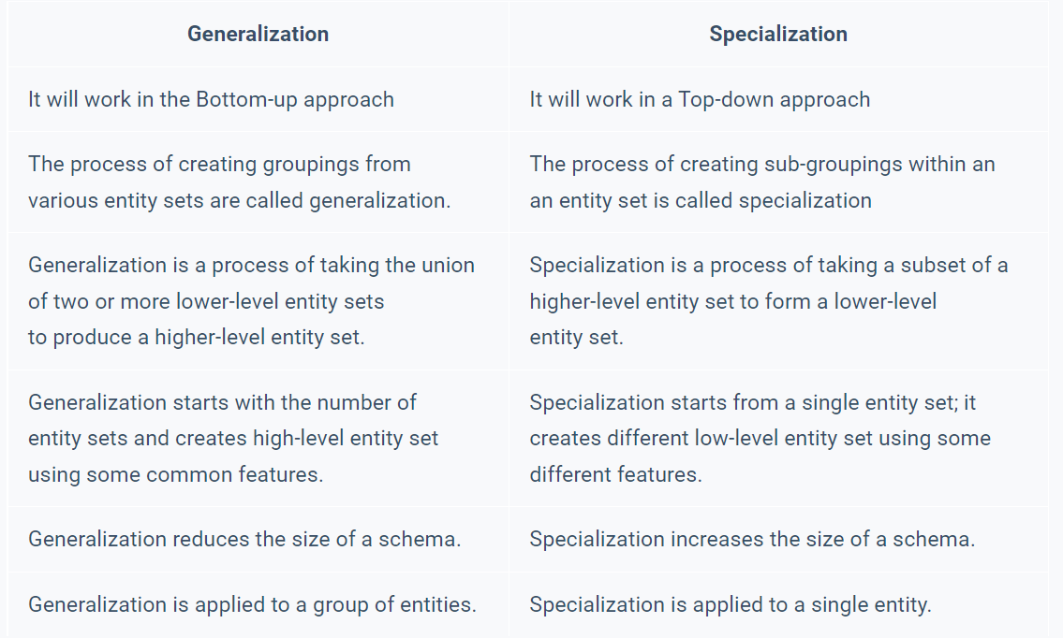

Slide 20
Constraints
Two basic constraints can apply to a specialization/generalization:
  Disjointness Constraint
  Completeness Constraint
    Total
    Partial
Disjointness Constraint
  Specifies that the subclasses of the specialization must be disjoint
    an entity can be a member of at most one of the subclasses of the specialization
  Specified by d in EER diagram
  If not disjoint, specialization is overlapping
    same entity may be a member of more than one subclass of the specialization
  Specified by o in EER diagram

Slide 21
Constraints
Completeness Constraint
  Total specialization/generalization specifies that every entity in the superclass must be a member of some subclass in the specialization/generalization.
    Shown in EER diagrams by a double line to connect the superclass to the circle.
  Partial specialization/generalization allows an entity not to belong to any of the subclasses.
    Shown in EER diagrams by a single line.
We have four types of specialization/generalization:
  Disjoint, total
  Disjoint, partial
  Overlapping, total
  Overlapping, partial
Generalization usually is total because the superclass is derived from the subclasses
  Contains only the entities that are in the subclasses

Slide 22
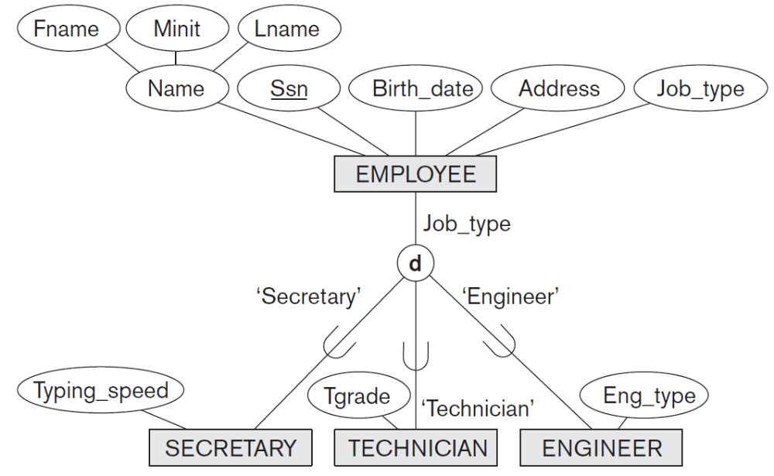
Example of disjoint partial Specialization

Slide 23
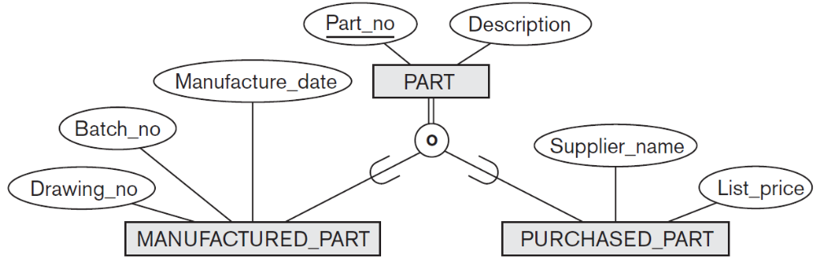
Example of overlapping total Specialization

Slide 24
Specialization/Generalization Hierarchies
A subclass may itself have further subclasses specified on it
  forms a hierarchy or a lattice
Hierarchy has a constraint that every subclass has only one superclass
  Called single inheritance
  Basically a tree structure
In a lattice, a subclass can be subclass of more than one superclass
  Called multiple inheritance

Slide 25
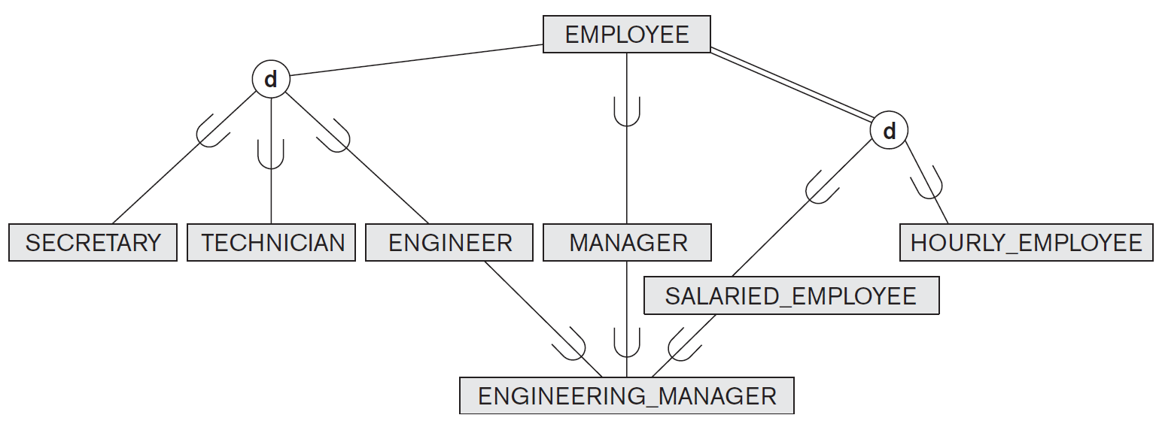
Specialization lattice

Slide 26
Specialization/Generalization Hierarchies and Lattices
In a lattice or hierarchy, a subclass inherits attributes not only of its direct superclass, but also of all its predecessor superclasses.
A subclass with more than one superclass is called a shared subclass (multiple inheritance)
In specialization, start with an entity type and then define subclasses of the entity type by successive specialization
  called a top down conceptual refinement process
In generalization, start with many entity types and generalize those that have common properties
  Called a bottom up conceptual synthesis process
In practice, a combination of both processes is usually employed

Slide 27
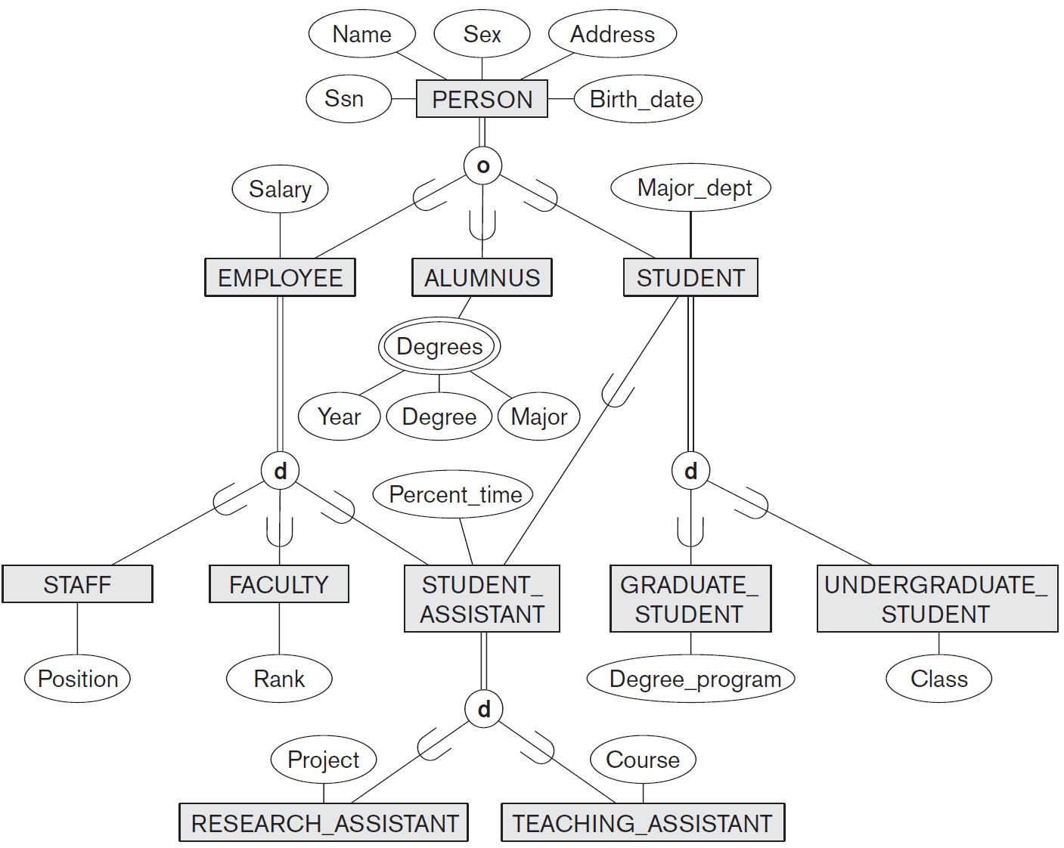
Specialization / Generalization Lattice Example (UNIVERSITY)

Slide 28
Categories (UNION TYPES)
All of the superclass/subclass relationships we have seen thus far have a single superclass.
A shared subclass is a subclass in
  more than one distinct superclass/subclass relationships
  each relationships has a single superclass
  shared subclass leads to multiple inheritance
In some cases, we need to model a single subclass relationship with more than one superclass.
Superclasses can represent different entity types.
Such a subclass is called a category or UNION TYPE.

Slide 29
Categories (UNION TYPES)
Example
  In a database for vehicle registration, a vehicle owner can be a PERSON, a BANK (holding a lien on a vehicle) or a COMPANY.
  A category (UNION type) called OWNER is created to represent a subset of the union of the three superclasses COMPANY, BANK, and PERSON.
A category member must exist in at least one of its superclasses.
A category has two or more superclasses that may represent distinct entity types.
Difference from shared subclass, which is a:
  subset of the intersection of its superclasses
  shared subclass member must exist in all of its superclasses
Category is a subset of the union of its superclasses.
A member of OWNER must exist in only one of the superclasses.

Slide 30
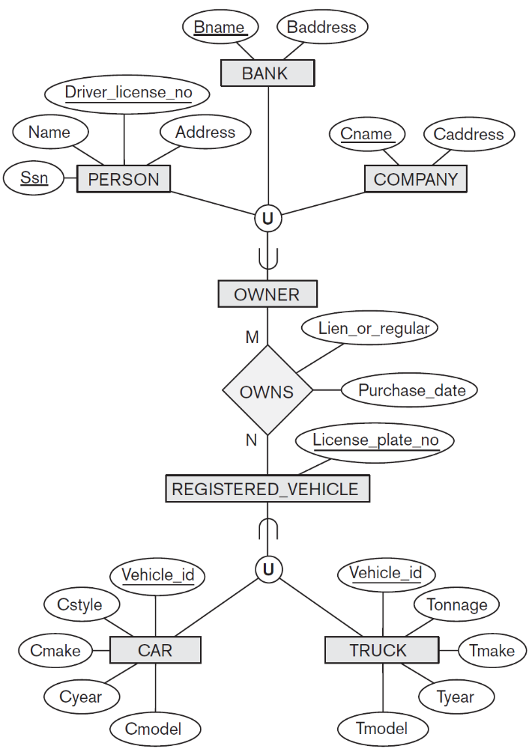
Categories (UNION TYPES)
Category can be total or partial.
Total category holds the union of all entities in its superclasses.
Partial category can hold a subset of the union.

Slide 31
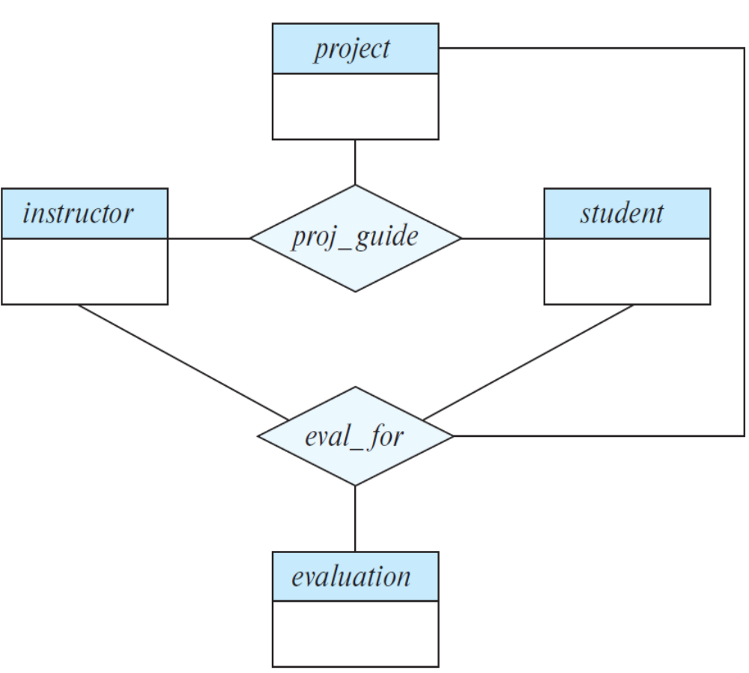
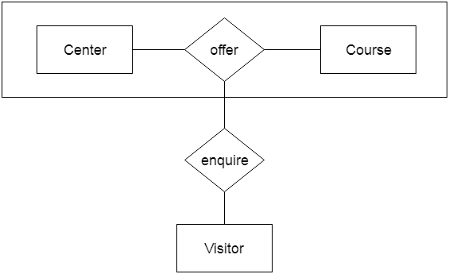
Aggregation
In aggregation, the relation between two entities is treated as a single entity. In aggregation, relationship with its corresponding entities is aggregated into a higher level entity.
Consider the ternary relationship proj_guide.
Suppose we want to record evaluations of a student by a guide on a project.
Center entity offers the Course entity act as a single entity in the relationship which is in a relationship with another entity visitor. In the real world, if a visitor visits a coaching center then he will never enquiry about the Course only or just about the Center instead he will ask the enquiry about both.
Notes:
An ER diagram is not capable of representing relationship between an entity and a relationship which may be required in some scenarios. In those cases, a relationship with its corresponding entities is aggregated into a higher level entity. Aggregation is an abstraction through which we can represent relationships as higher level entity sets.

Slide 32
Aggregation
Relationship sets eval_for and proj_guide represent overlapping information.
There is redundant information, since every instructor, student, project combination in eval_for must also be in proj_guide.
Every eval_for relationship corresponds to a proj_guide relationship.
Some proj_guide relationships may not correspond to any eval_for relationships.
We can’t discard the proj_guide relationship.
Eliminate this redundancy via aggregation
  Treat relationship as an abstract entity
  Allows relationships between relationships
  Abstraction of relationship into new entity

Slide 33
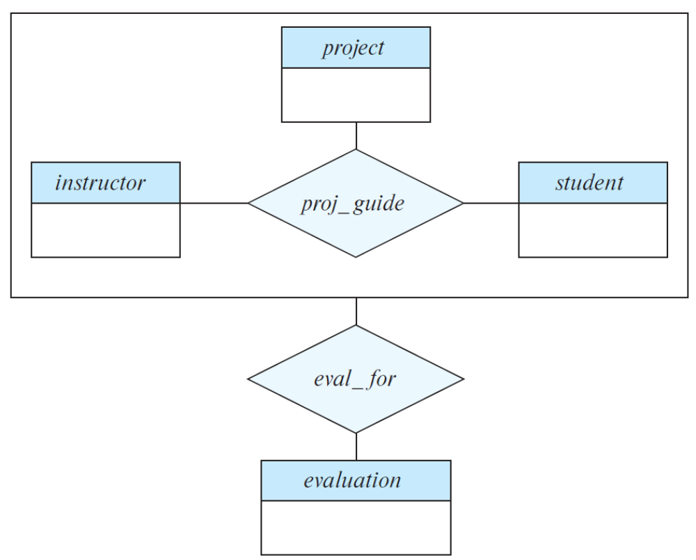
Aggregation
Aggregation is an abstraction through which relationships are treated as higher-level entities.
We regard relationship set proj guide (relating entity sets instructor, student, and project) as a higher-level entity set proj_guide.
A student is guided by a particular instructor on a particular project.
A student, instructor, project combination may have an associated evaluation

Slide 34
Aggregation
One limitation of the E-R model is that it cannot express relationships among relationships.
An ER diagram is not capable of representing relationship between an entity and a relationship which may be required in some scenarios.
In those cases, a relationship with its corresponding entities is aggregated into a higher level entity.
Aggregation is an abstraction through which we can represent relationships as higher level entity sets.

Slide 35
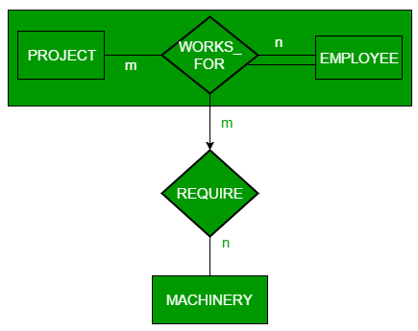
Aggregation
Employee working for a project may require some machinery.
REQUIRE relationship is needed between relationship WORKS_FOR and entity MACHINERY.
Using aggregation, WORKS_FOR relationship with its entities EMPLOYEE and PROJECT is aggregated into single entity.
Relationship REQUIRE is created between aggregated entity and MACHINERY.

Slide 36
Formal Definitions for the EER Model Concepts
A class is a set or collection of entities
  could be entity type, subclass, superclass, or category
Subclass S is a class whose:
  Type inherits all the attributes and relationship of a class C
  Set of entities must always be a subset of the set of entities of the other class C
    S ⊆ C
C is called the superclass of S.
A superclass/subclass relationship exists between S and C.
Specialization Z = {S₁, S₂,…, S_{n}} is a set of subclasses with same superclass G.
G is called generalized entity type (or the superclass of the specialization, or generalization of the subclasses {S₁, S₂, ..., S_{n}}).

Slide 37
Formal Definitions for the EER Model Concepts
Z is total if we always have:
  S₁ ∪ S₂ ∪ … ∪ S_{n} = G
Otherwise, Z is partial.
Z is disjoint if we always have:
  S_{i} ∩ S_{j} = Ø (empty-set) for i ≠ j
Otherwise, Z is overlapping.
Category or UNION type T
  A class that is a subset of the union of n different superclasses D₁, D₂,…,D_{n}, n>1
  T ⊆ (D₁ ∪ D₂ ∪ … ∪ D_{n})

